Slide 1







Taxi Repositioning System
Presentation by
Fourcast Analytics

Slide 2






THE PROBLEM TODAY
Drivers
COMPANIES
Wasted time in
low-demand areas
→ fewer rides, wasted fuel
PASSENGERS
Poor fleet distribution
→ reduced efficiency
Long wait times,
taxis not where demand is high
→ lower customer satisfaction

Slide 3

PROJECT GOAL
📍 Track taxis live across Singapore
📍 Identify over-supplied & under-served areas
📍 Recommend repositioning to optimize balance

Slide 4

pipeline workflow
1
2
3
Data Sources
Fetching Scripts
ETL
(Extract, Transform, Load)
📡 LTA Data Mall API
→ live taxi availability across Singapore (supply tracking).
🗺️ Kaggle Singapore City Geo-coordinates
→ postal codes + area boundaries for spatial tagging.
Python data fetching scripts to retrieve live taxi data via API.
Raw outputs (CSV/JSON) are loaded into Pandas DataFrames for further processing.
4
PostgreSQL Database
5
Analysis & Visualization

Slide 5


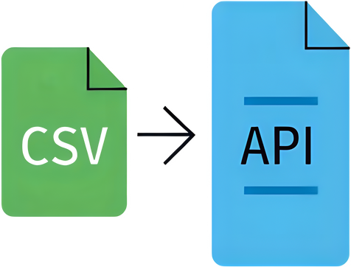

Challenges Faced
Dataset variety and extraction methods
Taxi, Telco, Food delivery
Csv, API, web scraping
No. of data sources
Common resource storage and access
Different notebooks (.ipynb) per person
Changing CSV paths, Postgres login repeatedly
Mixed communication tools (Slack, Teams, WhatsApp)
Schema design: Postgres vs Python
Diagram editor (visual drag-and-drop)
SQL query (manual definition)
Python (programmatic creation)
CSV and live API integration
Define relationship between sources
Merge CSV and API for output
Interpret outcomes

Slide 6
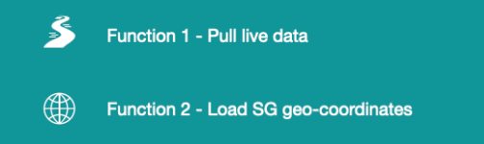
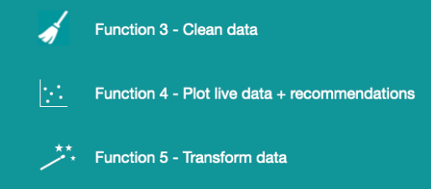
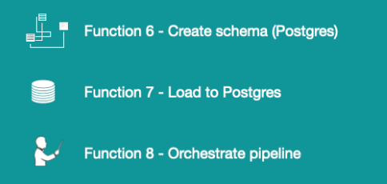
Micro-Batch Streaming ETL Pipeline
Extract
Transform
Load
+ orchestrate
API Request :: JSON Parsing :: Timestamp
File I/O :: Read_csv :: Schema Assumption
Null Handling :: De-duplication :: Re-indexing
Schema DDL :: Idempotent :: FK Integrity
Vectorisation :: Spatial tagging :: Haversine
Batch Insert :: Upsert keys :: Append Log
Collect real-time taxi locations from API.
Timestamp each record.
Import geo-coordinates and planning areas.
Map taxi positions to real-world locations.
Dimensional Model :: Surrogate key :: Normalisation
Batch Streaming :: Configurability :: Dependency Order
Remove duplicates, errors, and missing values.
Standardize formats for consistency.
Map taxis to neighborhoods.
Identify areas with too many or too few taxis.
Organize into structured tables.
Assign unique IDs and prepare for storage.
Create tables and relationships in PostgreSQL.
Ensure integrity and correct connections.
Insert cleaned and structured data.
Maintain batch updates and logging.
Run the pipeline in batches at regular intervals.

Slide 7
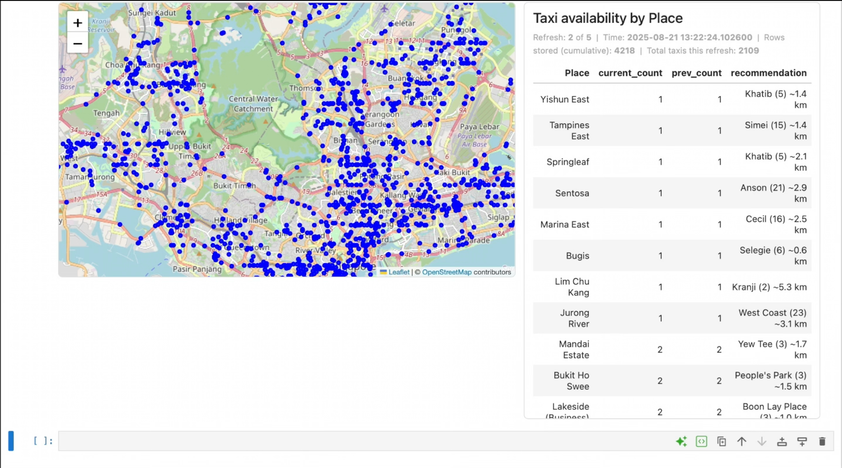
Taxi Repositioning System (TRS)
Rows Stored Before Process
Refresh Count / Batch
Total Available Taxis in SG
Current Available Taxi Locations
Processed / Inserted Data per batch

Slide 8
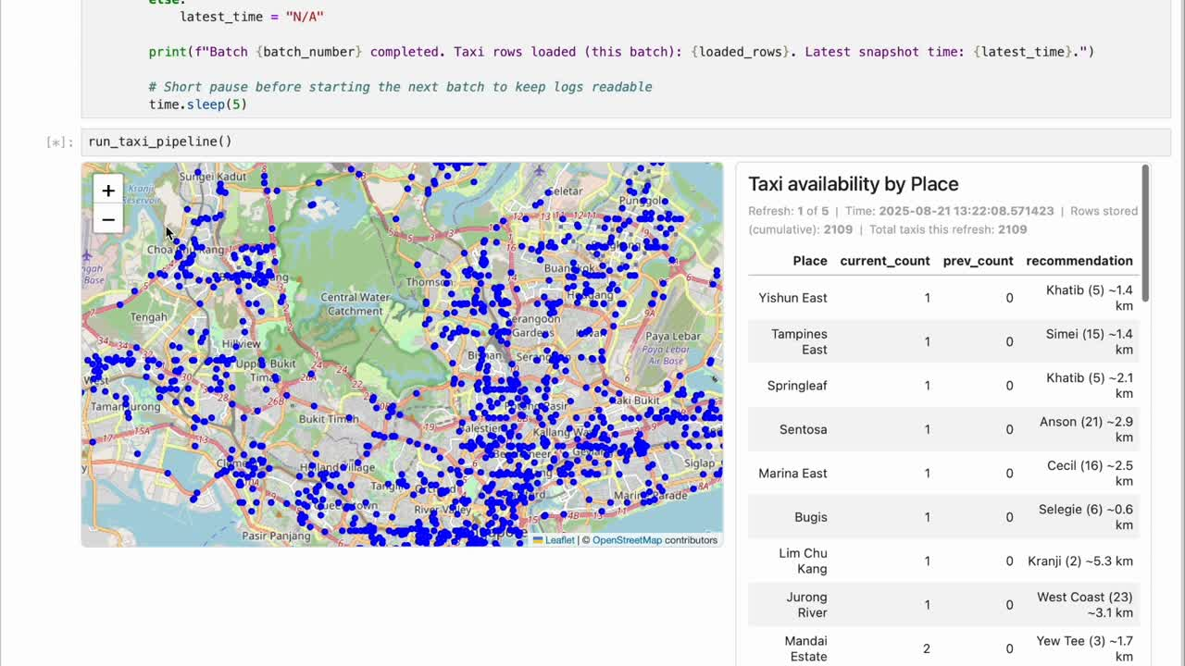
Taxi Repositioning System (TRS)

Slide 9
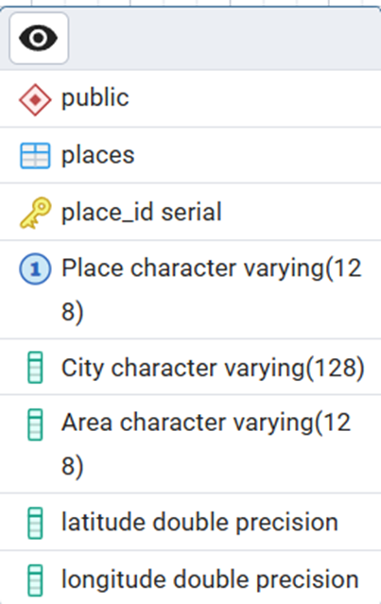
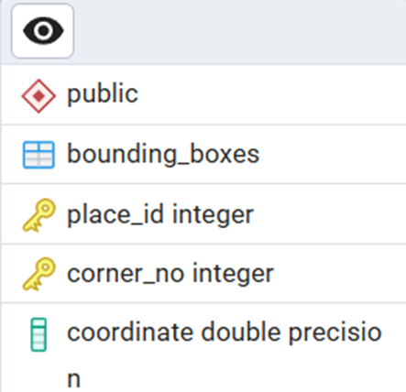
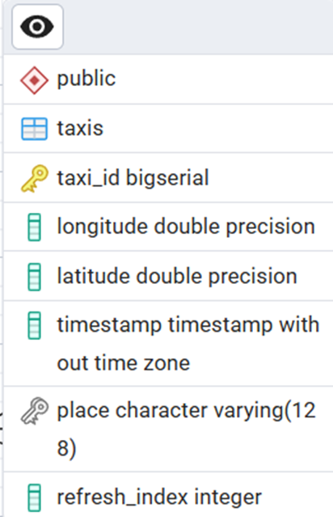
SQL Schema

Slide 10
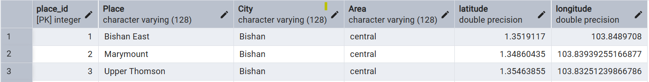
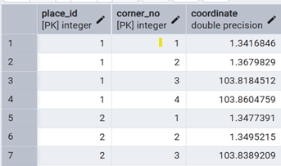
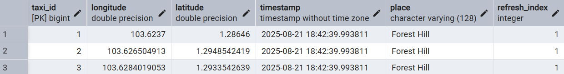
Place
Bounding Box
Taxis

Slide 11
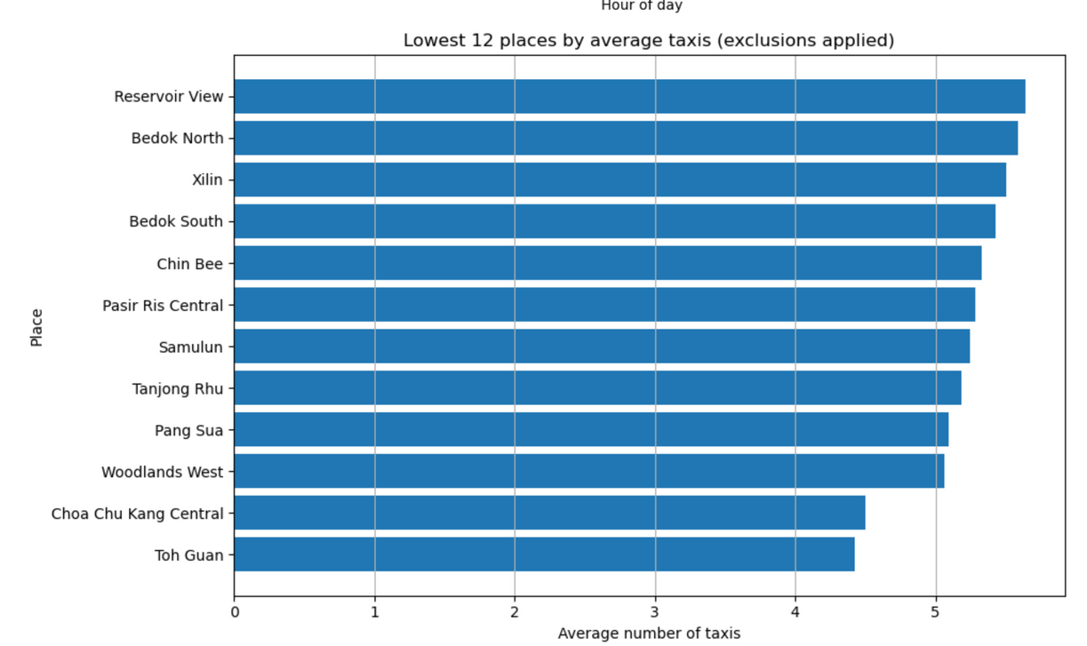
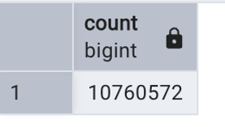
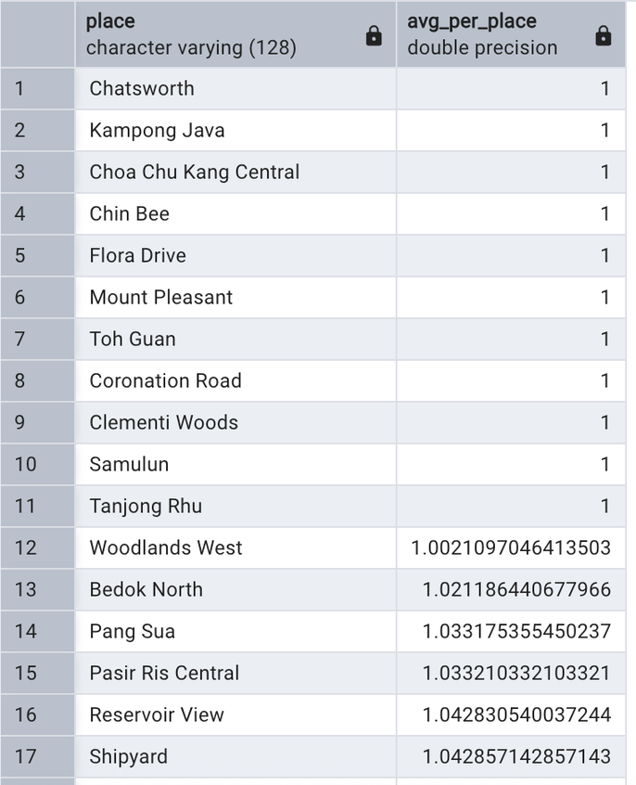
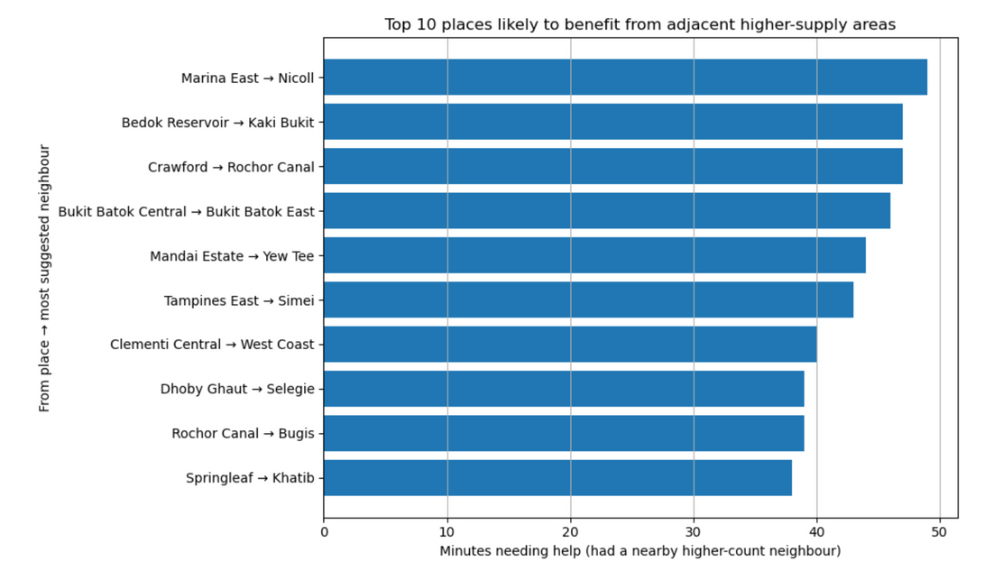
Select count(*) from Taxis
SELECT t."place",COUNT(*)::float / COUNT(DISTINCT t.timestamp) AS avg_per_place
FROM taxis t
JOIN places p ON t."place" = p."Place"
GROUP BY t."place"
ORDER BY avg_per_place ASC;

Slide 12

PROJECTed OUTCOMES
Projected outcomes
Drivers
🎯 15% faster pickups
🎯 8–12% more rides/hour
🎯 10% fewer empty trips
✅ guidance on underserved zones
PASSENGERS
✅ shorter wait times
COMPANIES
✅ real-time fleet visibility

Slide 13


Thank You
Interim project by
Fourcast Analytics:
Jack
Najihah
Rashpal
Swathi

